Slide 1

Vidya Pratishthan’s Kamalnayan Bajaj Institute of Engineering and Technology,
Baramati-413133
Department of INFORMATION TECHNOLOGY Engineering
PROJECT TITLE:
Common Skin Disease Diagnosis and Prediction
Group no. :- 15
RUCHIKA KIRAN GAIKWAD (2243022)
SAMRUDDHI MAHESH GAIKWAD(2243020)
ATHARVA PRAVIN GAURAV(2243059)
DEEP RAJESH KHADKE(2243025)
Guide: Mr. R. Panchal

Slide 2
Content
Problem statement.
Objective.
Introduction.
Requirement-
System Requirement.
Algorithm list.
System Design.
System Architecture.
Dataset.
Implementation – CNN,MobileNet,ResNet.
GUI
Project Plan.
Literature Review.
Conclusion
References.

Slide 3
Problem Statement
Develop a system that uses deep learning techniques to predict skin diseases from patient-provided images and provide information of prevention and treatment methods.

Slide 4
Objective
To develop a system that can accurately identify and classify skin diseases from images.
To improve the accuracy of diagnosis of skin diseases.
To reduce the cost of diagnosis of skin diseases.
To improve access to diagnosis of skin diseases, especially in rural areas.
To help people with skin diseases get the treatment they need early.
To help prevent the spread of skin diseases.

Slide 5
Introduction
Skin is an extraordinary and sensitive human structure and is suffered from various known and unknown diseases. Diagnosing skin disease is a complicated task.
This challenge can be solved using Deep Learning and Image Processing techniques.
Deep Learning is a subset of machine learning, it uses large datasets, it is a type of machine learning that imitates the way humans gain certain type of knowledge.
Convolutional Neural Network(CNN) is a network architecture for deep learning which learns directly from data, eliminating the need for manual feature extraction and it is a feed forward neural network used to analyze images by processing data.
ResNet Residual Networks is a classic neural network used as a backbone for many computer vision tasks.
MobileNet is a type of convolutional neural network designed for mobile and embedded vision applications.

Slide 6
Requirements
Functional Requirements –
1. Calculation/Data Collection
2. Data Manipulation
3. Processing
Non Functional Requirements –
1. Performances
2. Security
3. Usability
4. Compatibility
5. Efficiency
6. Portability

Slide 7
System Requirements
Software Requirements –
1. Operating System: Windows 11, 64 bit
2. Technology: Python
3. IDE : Jupyter Notebook
4. Frontend: Android Studio
Hardware Requirements –
1. Hardware: intel core i5.
2. Speed: 2.40 GHz
3. RAM: 8GB

Slide 8
Algorithm List
Deep learning- Deep learning is an area of machine learning that involves the use of artificial neural networks, designed to resemble the human brain, to analyze and solve complex problems.
Convolutional Neural Network- CNN is a type of deep learning algorithm that has revolutionized the field of computer vision.
ResNet-Residual Network (ResNet) is a deep learning model used for computer vision applications.
MobileNet- MobileNet is a computer vision model open-sourced by Google and designed for training classifiers.

Slide 9
System Design
Data Gathering-The proposed system has been assessed on skin diseases images which is collected from the publicly available dataset based on Skin- Cancer-MNIST.
Data Cleaning-Dirty data can cause confusion and results in unreliable and poor output.
Model Building- We have used Convolutional Neural Network (CNN) , ResNet , MobileNet.
Model Evaluation- Every model is evaluated based on the accuracy achieved and the loss obtained. There are two accuracies involved:
Validation accuracy
Test Accuracy

Slide 10
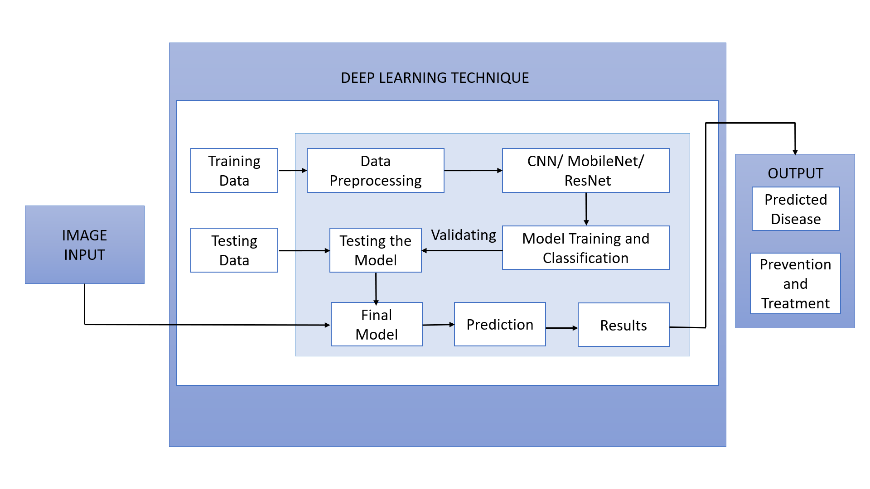
System Architecture

Slide 11
Data Flow Diagram
Start
Achieve
Highest
Accuracy
Collection of Data
Final Results
Defining Architecture
Stop
Testing
Using algorithms by adding layers to predict skin disease
Data Division- train(80%) and test(20%)
Training Model

Slide 12
UML Diagrams
Use Case Diagram-
Input Information
Get Environment Details
Client
View Decisions
Reasons for Decision
Exit System

Slide 13
UML Diagram
Level 0 Data Flow Diagram
Level 1 Data Flow Diagram
Skin Image
Analysis
Disease Result
Skin Image
Analysis
Disease Result
Android Camera
Digital Camera
Image Processing

Slide 14
UML Diagram
Activity Diagram
Image processing
Recognition
Read Image
Yes
Yes
Prediction
No
No

Slide 15
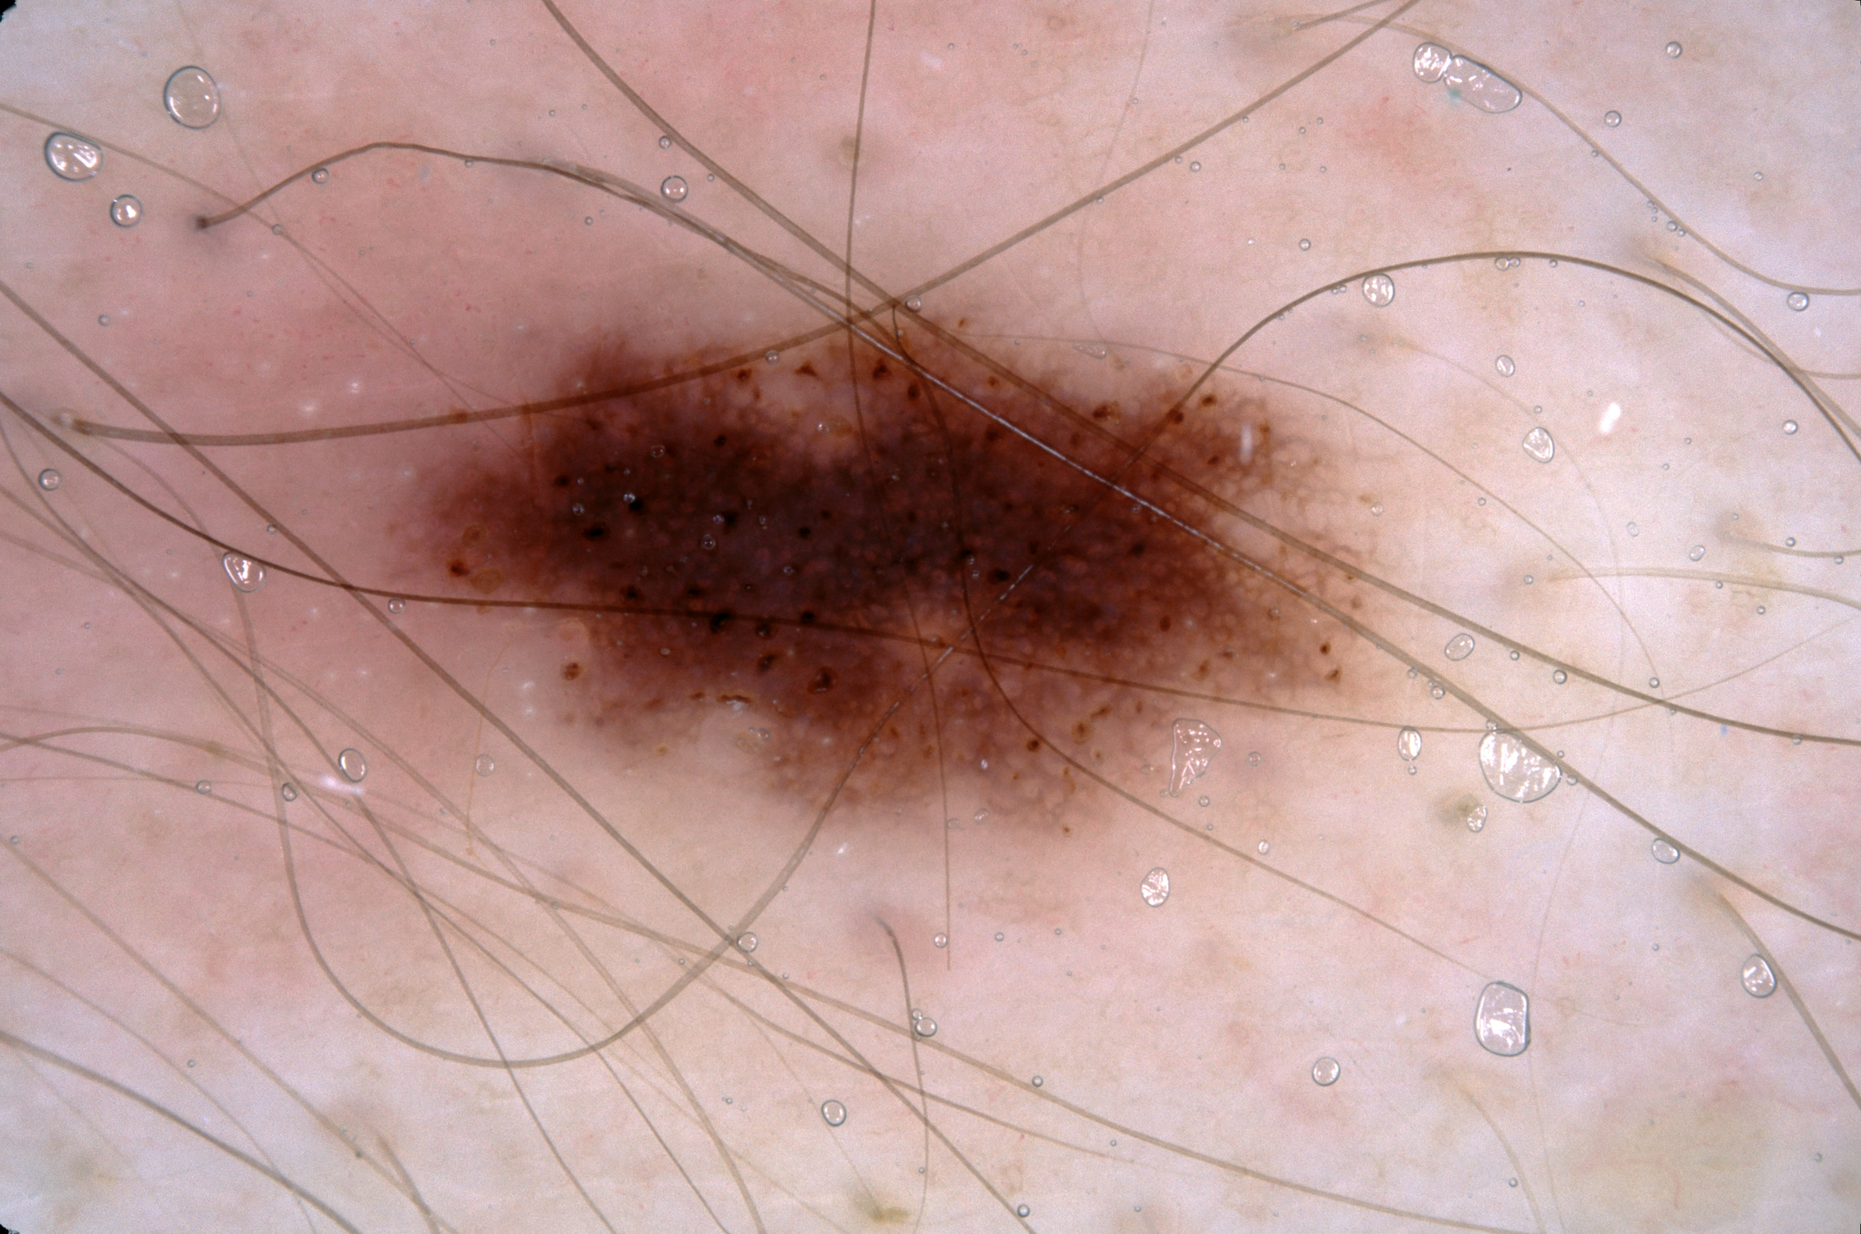
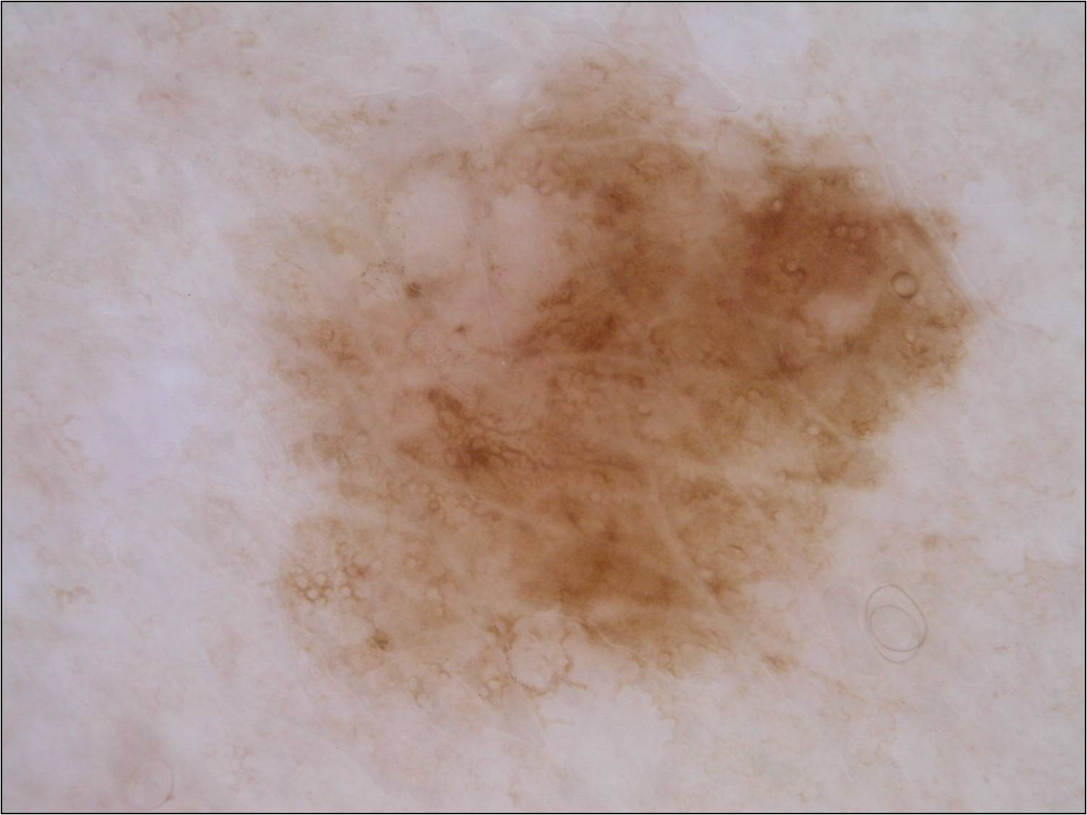
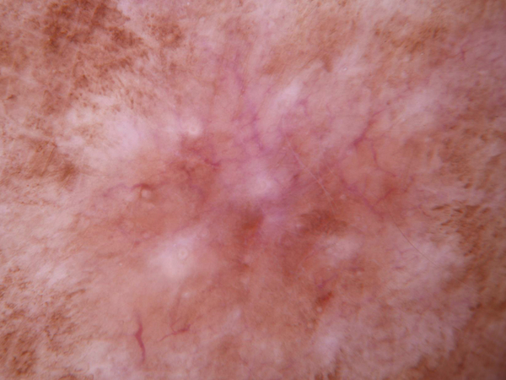
Dataset:
Skin Cancer MNIST: HAM10000.
10000+ images 64x64 pixels.
MNIST dataset
Dataset consist of 7 classes
Sample images:

Slide 16
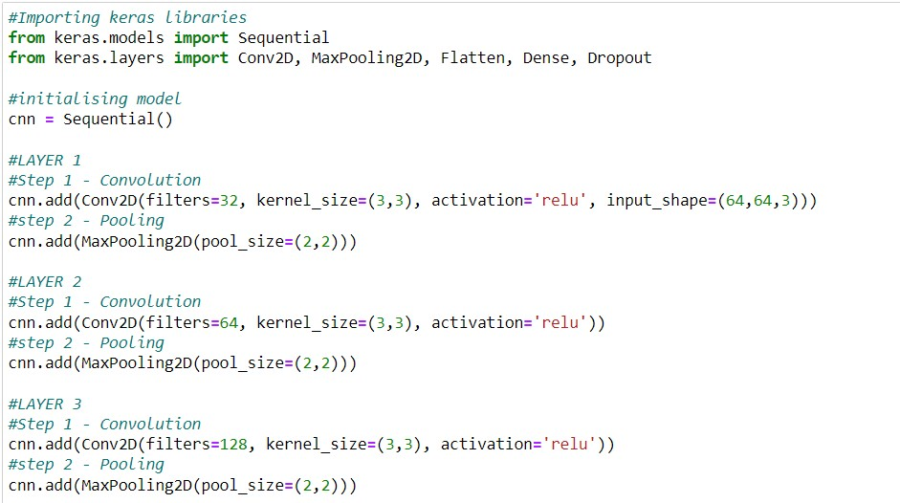
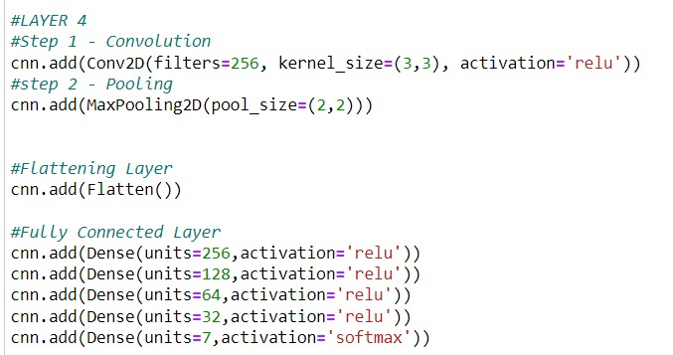
CNN Implementation:

Slide 17

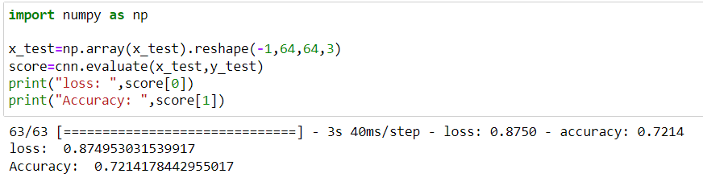
CNN Implementation:

Slide 18
MobileNet:
MobileNet is a type of convolutional neural network designed for mobile and embedded vision applications. They are based on a streamlined architecture that uses depthwise separable convolutions to build light weight deep neural networks that can have low latency for mobile and embedded devices.
In MobileNet we have 85 pre-define layers along with 4 user-defined layers which 1st layer is the dropout layer, the 2nd average pooling, and 3rd dense layer with 128 neurons. The last layer of this model is the output layer with 7 neurons .
All the layers are followed by batch normalization and ReLU activations. The final classification layer has a sigmoid activation.

Slide 19
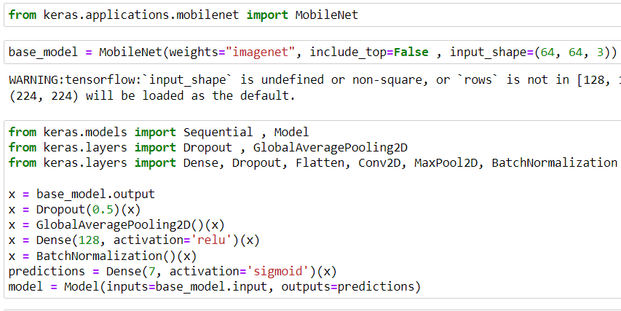
MobileNet Implementation:

Slide 20
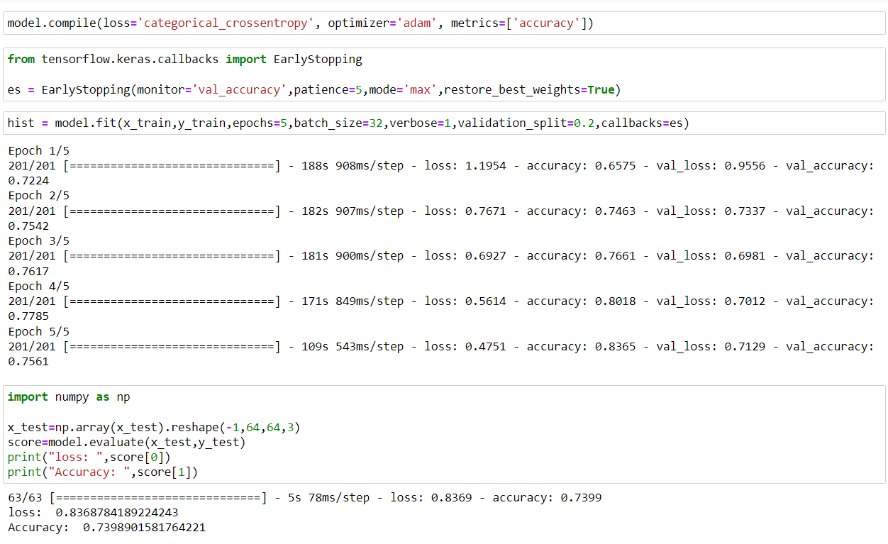
MobileNet Implementation:

Slide 21
ResNets:
ResNets are a common neural network architecture used for deep learning computer vision applications like object detection and image segmentation. Residual Network (ResNet) is a Convolutional Neural Network (CNN) architecture that overcame the “vanishing gradient” problem, making it possible to construct networks with up to thousands of convolutional layers, which outperform shallower networks.
Layers-
ResNet50 :
There are 50 pre-defined layers in this model, and four new layers are added. Which 1st and 3rd layers are the drop layer and 2nd layer is a dense layer with 128 neurons. The last layer is the dense output layer with 7 neurons and a Softmax activation function.

Slide 22
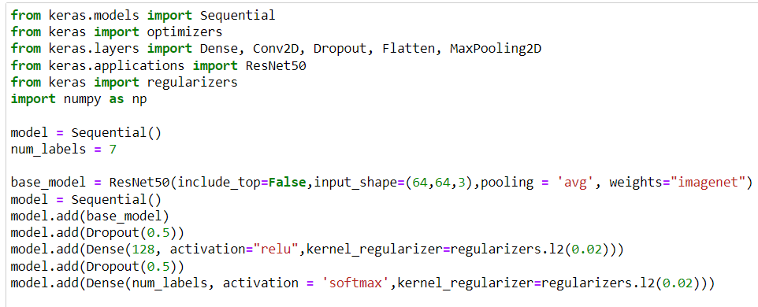
ResNet Implementation:

Slide 23
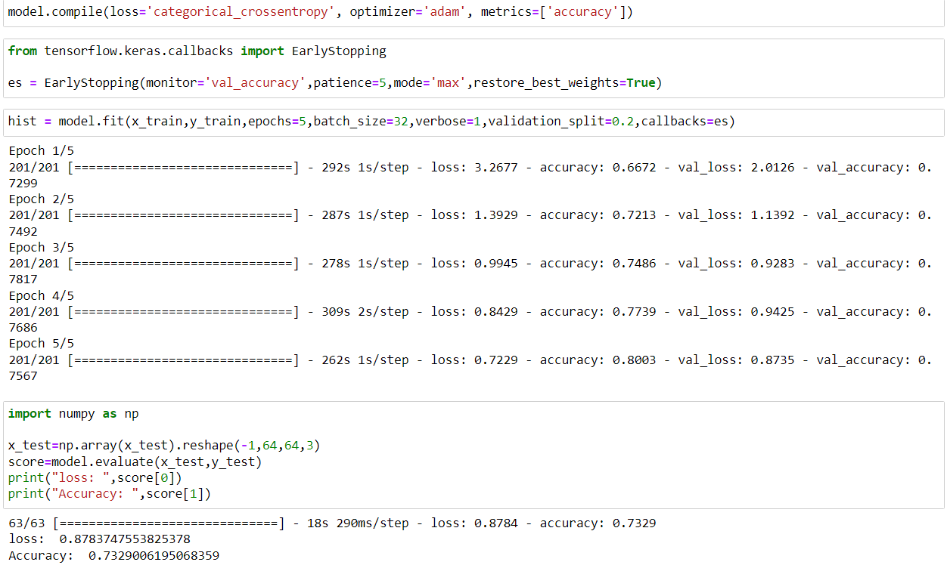
ResNet Implementation:

Slide 24
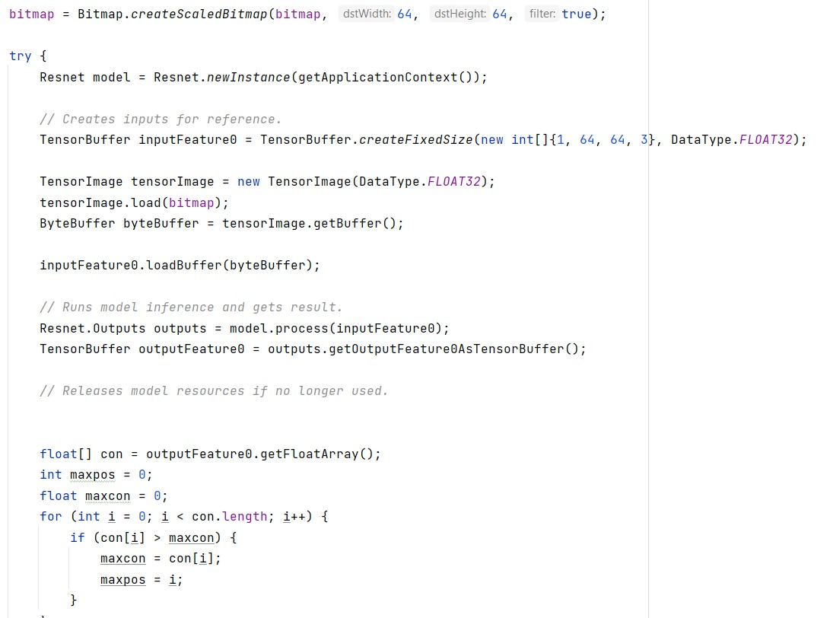
Android Implementation

Slide 25
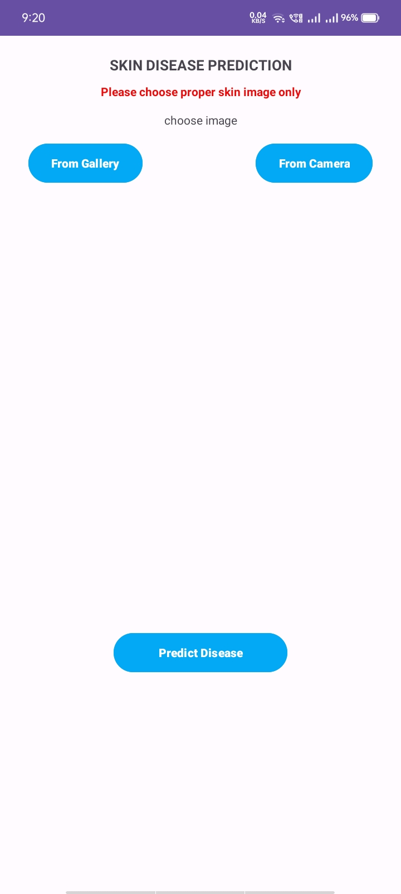
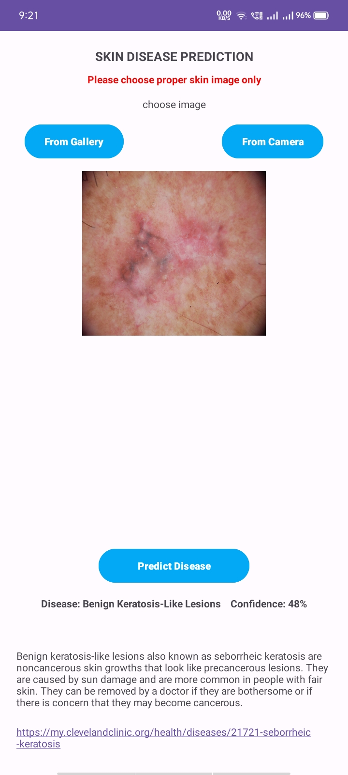
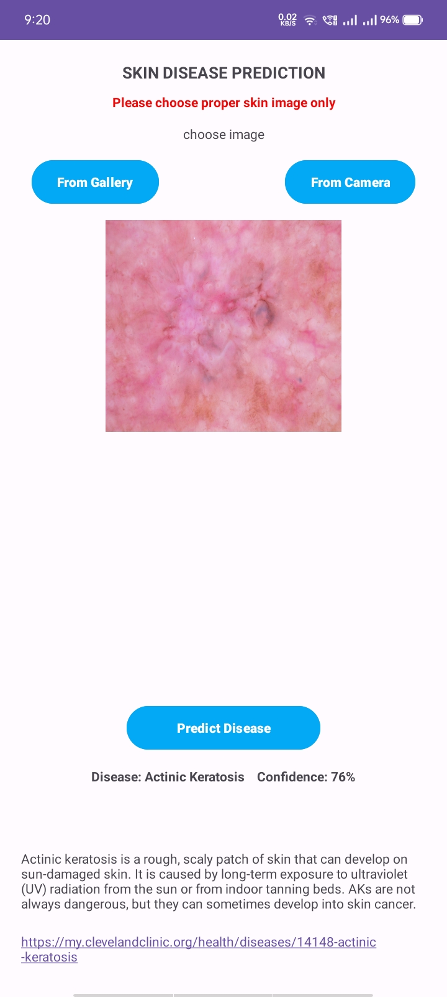
GUI:

Slide 26
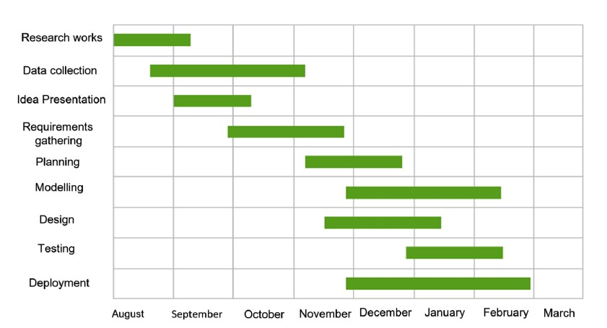
Project Plan:
April

Slide 27
Project Plan:
Sr.no | Task | Duration | Date
1 | Research Work | 1 week | 20/8/22 to 27/8/22
2 | Data Collection | 1 week | 25/8/22 to 2/9/22
3 | Idea Presentation | 1 day | 2/9/22
4 | Literature Survey | 1 week | 2/9/22 to 9/9/22
5 | Planning | 1 week | 5/9/22to12/9/22
6 | Designing | 3 weeks | 12/9/22 to 3/10/22
7 | Implementation | 18 weeks | 2/10/22 to 1/2/2023
8 | Testing | 3 weeks | 2/2/2023 to 28/2/2023
9 | Report | 4 weeks | 1/3/2023 to 15/4/2023

Slide 28
Literature Review
1. Kritika Sujay Rao, 2. Pooja Suresh Yelkar, 3. Omkar Narayan 4. Pise, Dr. Swapna Borde “Skin Disease Detection using Machine Learning” This papers approach is based on the pre-processing, Deep learning algorithm, training the model, Validation and classification phase. They have performed Experiments on 10010 images and has achieved 93% accuracy for seven-class Classification using Convolution Neural Networks (CNN) with the Keras Application API.

Slide 29
Literature Review
1. Ahmed A. Elngar, 2. Rishabh Kumar, 3. Amber Hayat, 4. Prathamesh Churi “Intelligent System for Skin Disease Prediction using Machine Learning”
This paper effectively proposed (CNN-SVM –MAA) system which combines Convolutional Neural Network with Support Vector Machine Classifier to develop a Mobile Android Application The results obtained showed the adequacy of the proposed (CNN-SVM -MAA) system how many skin diseases images have been detected from skin disease dataset. Which lead to detect skin disease and provide the user with the disease name and treatment related prescription with high accuracy.

Slide 30
Literature Review
1. Sourav Kumar Patnaik, 2. Mansher Singh Sidhu, 3. Yaagyanika Gehlot, 4. Bhairvi Sharma and P Muthu “Automated Skin Disease Identification using Deep Learning Algorithm” In this research the method of detection was designed by using pre trained SVM and naive bayes. This research paper shows the effective role played in the detection skin diseases in Saudi Arabia because it has very hot weather for the presence of weather these indicates that Skin diseases are wide spread. The research supports medical efficiency in south Arabia. This expert system pertains disease recognition accuracy of 85% for Eczema, 95% for Impetigo and 85% for Melanoma. Both image-based technique and questionnaire technique help to increase reliability and performance of the system.

Slide 31
Constraints
Image recognition is a big challenge.
Dealing with blur images, images should not be blurred and should be in proper format and angle.
Images should be taken in an illuminated area.
It does not support GIF or video format files.
Images other than human skin should not be included.
Only seven common skin diseases are detected.
System is unable to show the position of the damage.
It detects only disease but it is unable to give the exact damage.

Slide 32
Conclusion
In this work, a model for the prediction of skin diseases using deep learning algorithms is created. It has been found that by using feature compounding and deep learning, we can achieve higher accuracy and also predict many more diseases than other previous models. Like the previous models, in this one area of use, we were able to report a maximum of six skin conditions with a maximum accuracy of 75%. The choice of which algorithm for skin disease prediction depends on the number of factors availability of computation resources and desired accuracy. Using different models we have tested our accuracy up to CNN-72%, MobileNet – 73%, and ResNet-73%.

Slide 33
References
[1] Kritika Rao, Pooja Yelkar, Omkar Pise and Dr. Swapna Borde, and,"Skin Disease Detection using Machine Learnings", 2021.
[2] Ahmed A. Elgar, Rishabh Kumar, Amber Hayat, Prathamesh Churi, "Intelligent System for Skin Disease Prediction using Machine Learning" , August 2021
[3] Sourav Kumar Patnaik, Manser Singh Sidhu, Yaagyanika Gehlot, Bhairvi Sharma, and P Muthu, "Automated Skin Disease Identification using Deep Learning Algorithm", August 2018

